Slide 1


K.L.E Society’s
C. B. Kore Polytechnic, Chikodi.
Dinesh Jadage
339CS22016
339CS22024
339CS23701
339CS22020
Kishan Mangasule
Abhishek Shintre
Ishwar Gandh

Slide 2
Presentation for hotel management system

Slide 3
Contents
INTRODUCTION
OBJECTIVES
HARDWARE AND SOFTWARE REQUIREMENTS
TECHNOLOGIES AND LANGUAGES
DATA FLOW DIAGRAM
ERD DIAGRAM
BENEFITS
SCREENSHOTS OF PROJECT
FUTURESCOPE
CONCLUSION

Slide 4
INTRODUCTION
A Hotel Management System (HMS) is a software application designed to manage and automate hotel operations such as reservations, front desk activities, housekeeping, billing, and customer service. It enhances efficiency, improves guest experience, and streamlines workflows.
Additionally, it enables hotels to track occupancy rates, manage resources effectively, and personalize guest services, ultimately boosting customer satisfaction and revenue. With the ability to integrate with third-party services such as travel agencies and payment gateways, a modern hotel management system ensures seamless operations while maintaining data security and compliance with industry regulations.

Slide 5
OBJECTIVES OF HOTEL MANAGEMENT SYSTEM
The objective of this project is to develop an efficient and innovative Hotel Management System (HMS) that enhances operational efficiency, improves guest experiences, and drives business success.
The system aims to streamline key hotel operations such as reservations, check-ins, check-outs, billing, and housekeeping management while ensuring seamless coordination between different departments.
By prioritizing guest satisfaction, the system will enable hotels to offer personalized services, manage customer relationships effectively, and build a strong reputation.
Additionally, integrating modern technologies and automation will help reduce manual errors, optimize resource utilization, and improve overall business performance.

Slide 6
Hardware and software requirements
Hardware:
Computers/Mobile Devices
Servers (Cloud or On-Site)
Reliable Network (Wi-Fi)
POS Terminals(Points of Sale)
Software:
PMS (Property Management)
POS (Points of Sale)
Channel & CRM (Booking & Guests)
Accounting/Housekeeping Tools

Slide 7
Technologies AND LANGUAGES
FORNTEND
SHELL
JAVASCRIPT
HTML,CSS
IDE
Vscode
Notepad
BACKEND
PHP
MYSQL
XHAMP

Slide 8
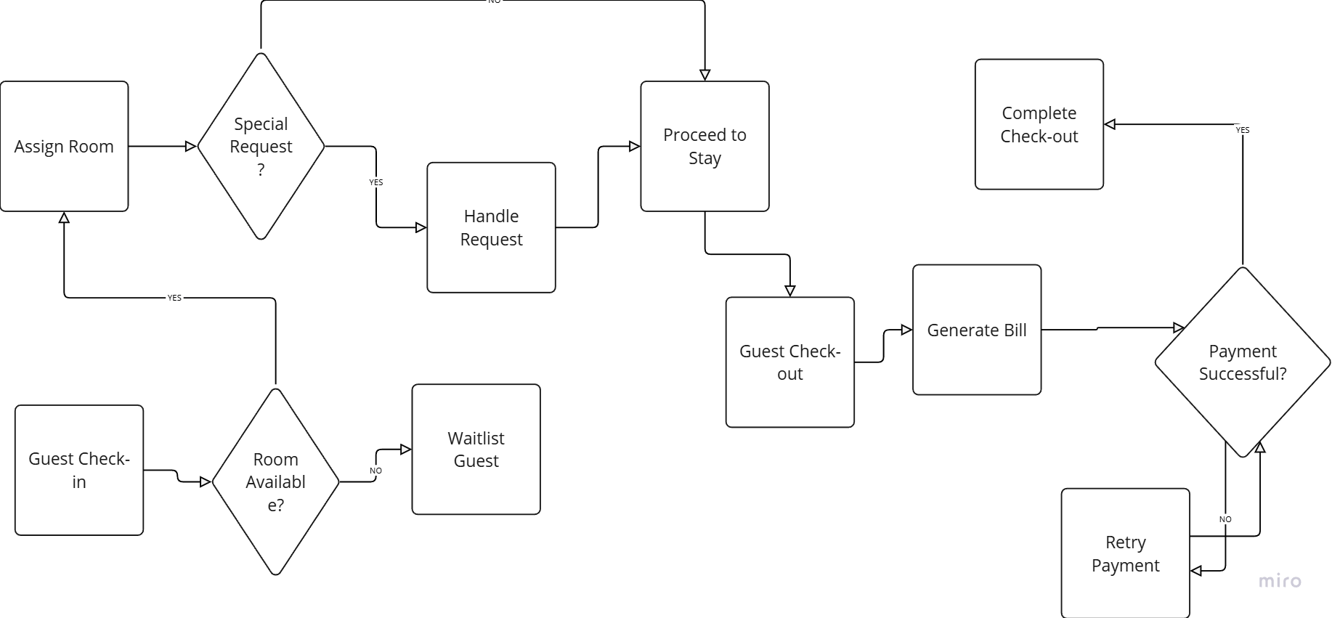
Data flow diagram of hotel management

Slide 9
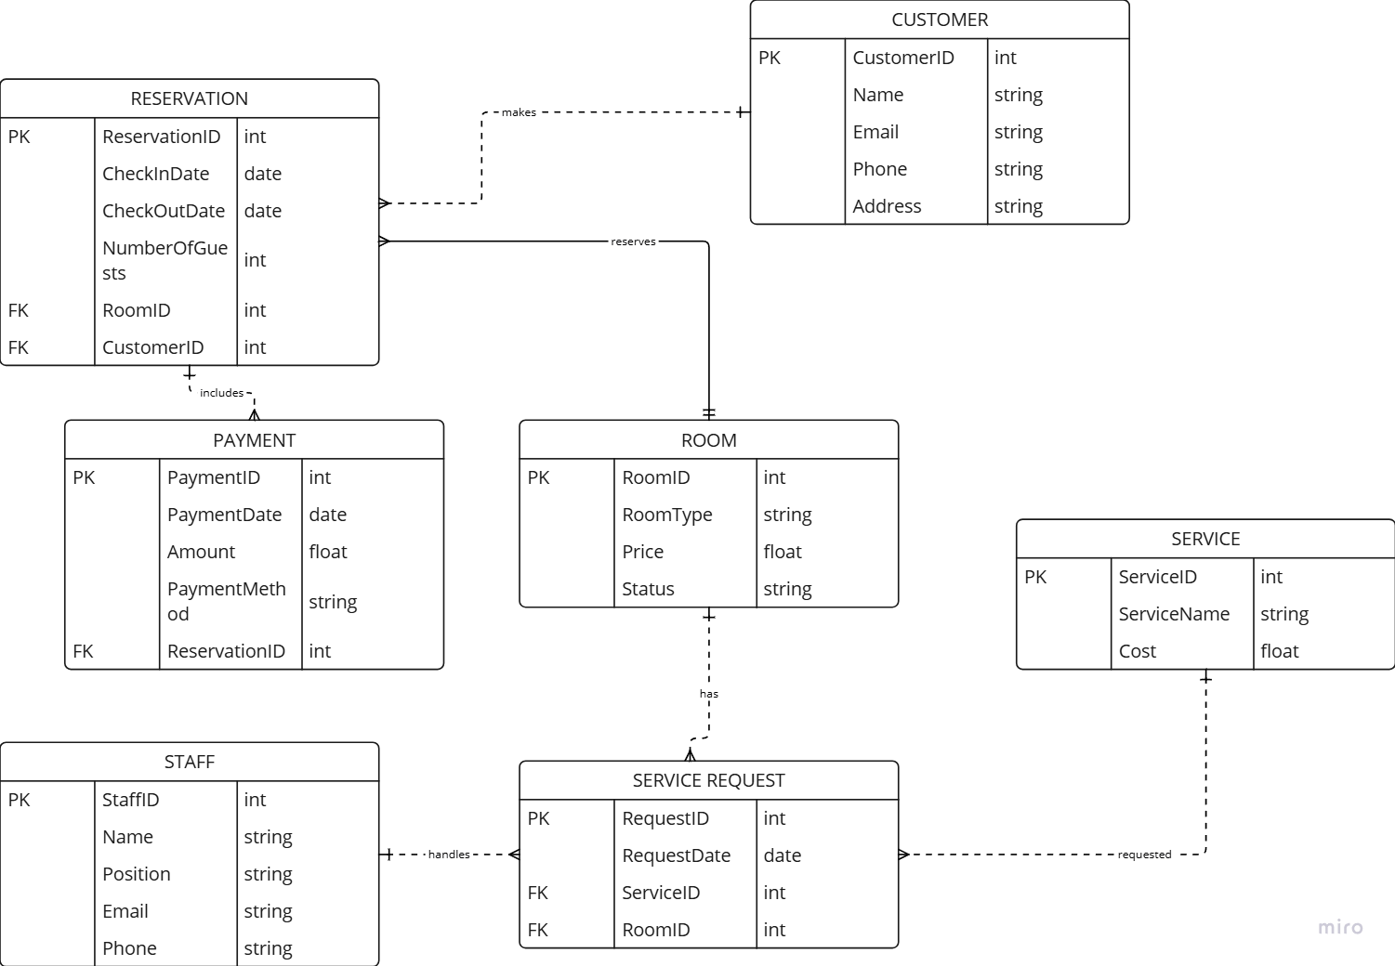
Er diagram for hotel management.

Slide 10
Benefits
Boosted Efficiency: Automate tasks, save time.
Enhanced Guest Experience: Personalized service, faster check-in.
Increased Revenue: Optimize bookings, manage sales.
Streamlined Operations: Centralized data, improved reporting.
Improved Online Presence: Manage bookings, enhance reputation.
Reduced Costs: Minimize errors, control inventory.

Slide 11
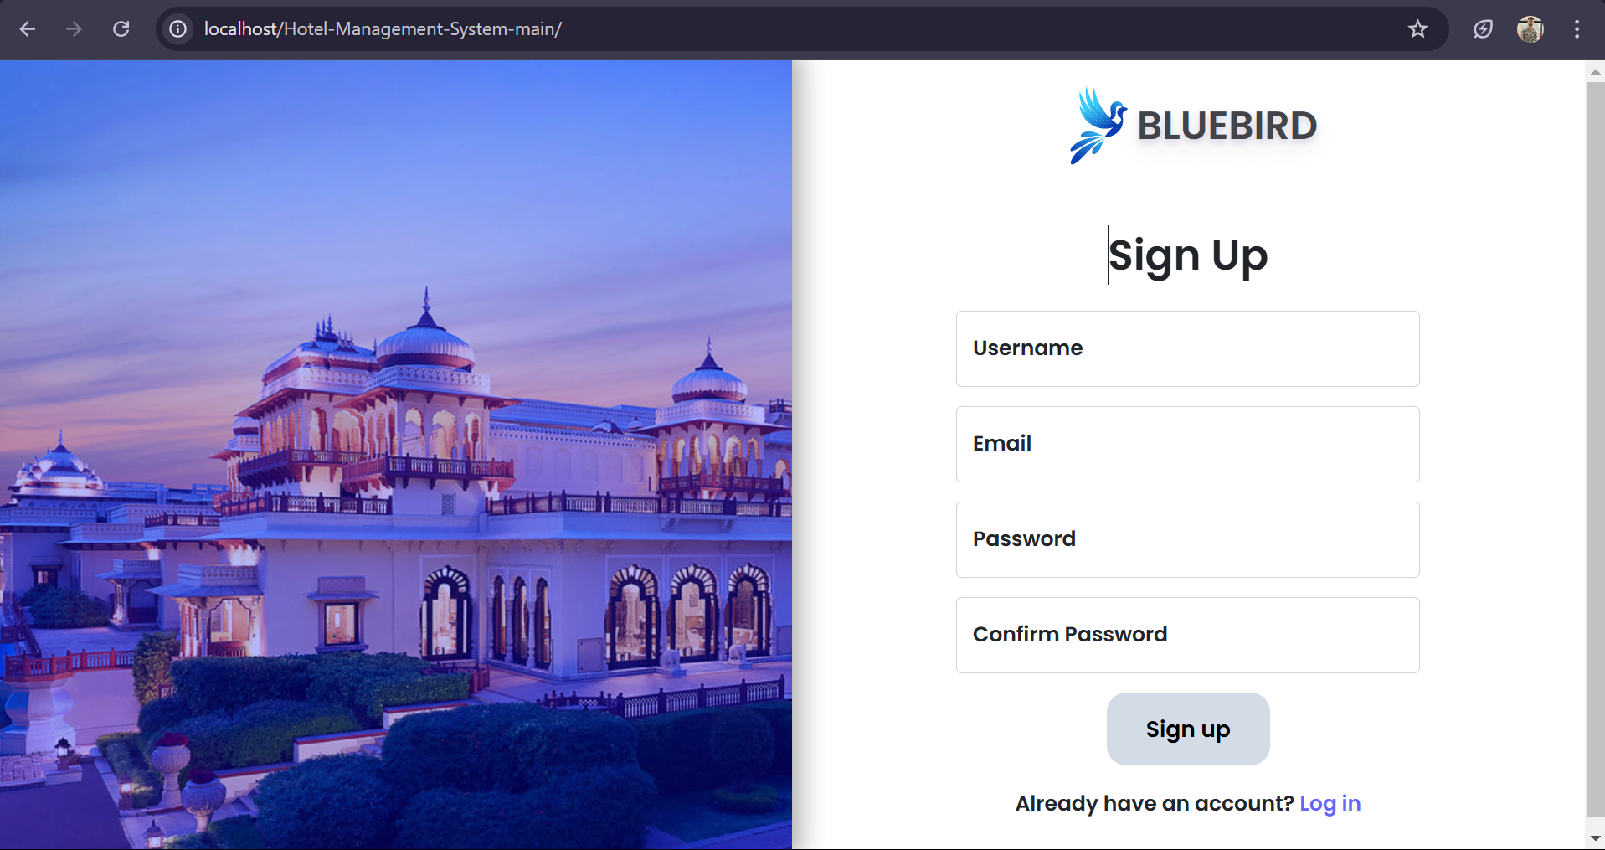
Sign up or register page

Slide 12
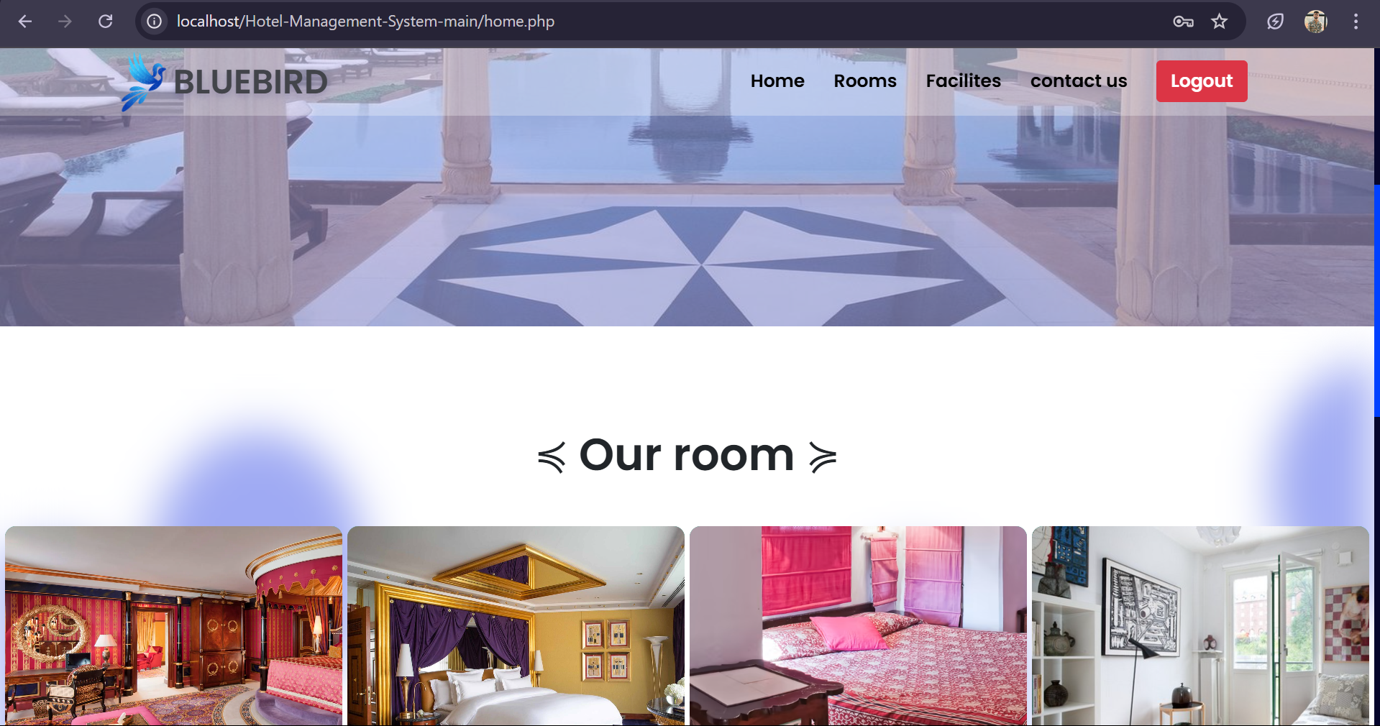
Home interface

Slide 13
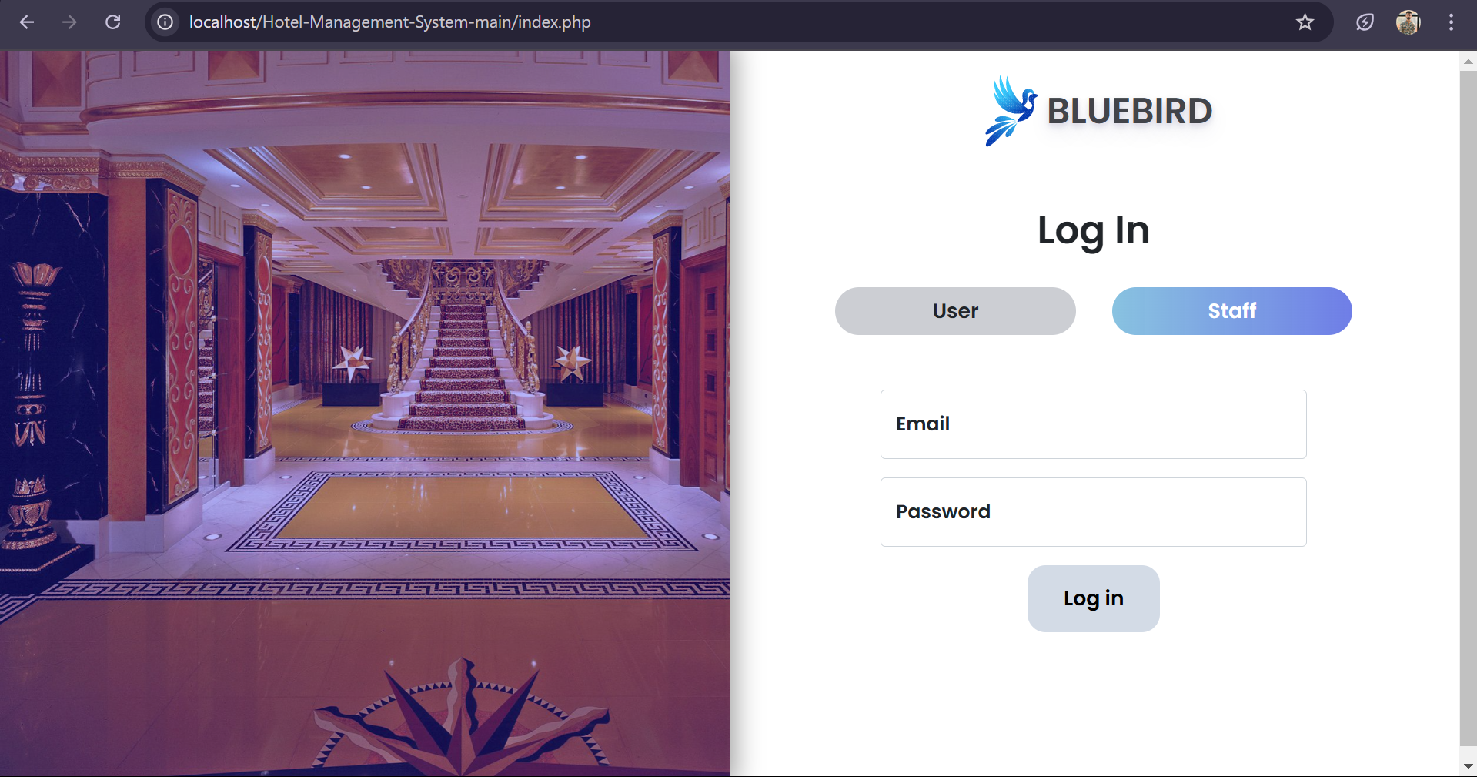
Staff login page

Slide 14
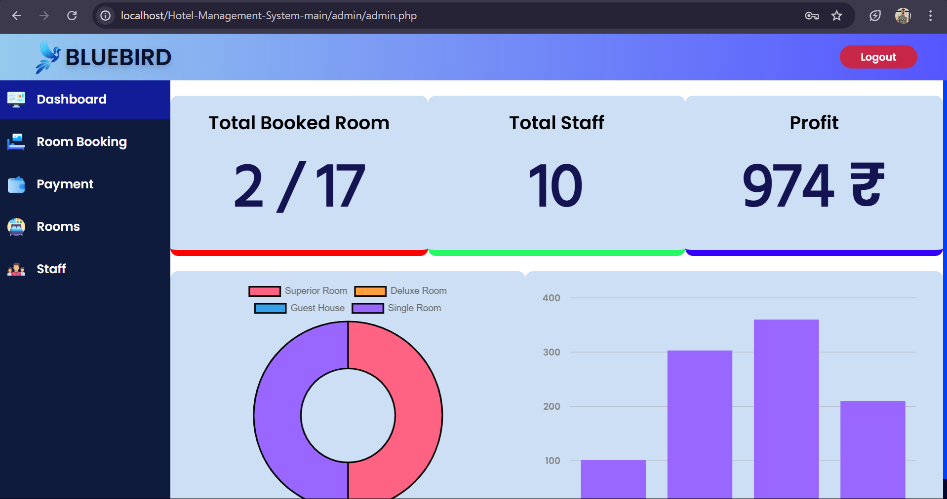
staff interface

Slide 15
Future scope for hotel management
Personalized Stays: Hotels will know and cater to each guest's needs.
Eco-Friendly Focus: Friendly practices will be more important for trust.
Tech-Powered Comfort: Easier digital check-ins and room controls.
Unique Experiences: Hotels will offer more than just a place to sleep with needed stuffs.
Flexible Spaces: Rooms and lobbies will adapt to uses or Demands of Costumer.
Wellness Matters: Guests will want healthy and relaxing stays.
Smart Decisions: Hotels will use data to improve their business.

Slide 16
Conclusion
Effective management is the key to success in any industry, particularly in hospitality, where seamless operations and strategic decision-making play a crucial role. Prioritizing guest experiences is essential, as customer satisfaction directly impacts a hotel's reputation and long-term success. Embracing innovation and staying adaptable to evolving industry trends allow businesses to maintain a competitive edge, improve efficiency, and enhance service quality.

Slide 17


